Slide 1
WCCI2020 Panel on Research Funding: EU
Włodzisław Duch
Neurocognitive Laboratory, Center for Modern Interdisciplinary Technologies, Dept. of Informatics, Faculty of Physics, Astronomy & Informatics,
Nicolaus Copernicus University Google: Wlodek Duch
WCCI 2020, Glasgow, UK, 19-24.07.2020

Slide 2
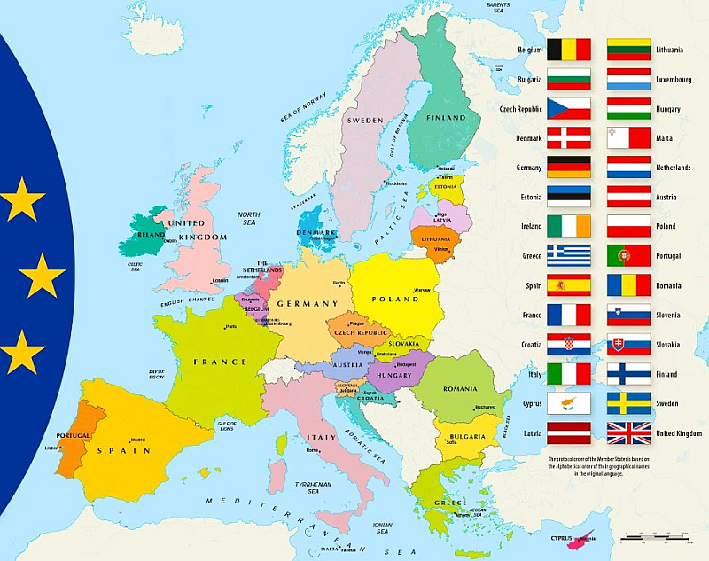
27 ++ countries

Slide 3
Research & Innovation in EU
Growing investment in joint research & innovation programs: FP6 (2002-6) only 19 B€, FP7 (2007-13) was 50 B€, last framework: Horizon 2020 budget for 2014-20 was ~75 B€. Horizon EU proposed budget ~150 B€ (under negotiations, without UK).
This is a small fraction of all R&D in EU countries, ex. 320 B€ in 2017. Target for 2020 was 3% GDP, reality 2.06%. USA about 2.8%.
Vast majority of AI related research is included in the common basket of AI RESERACH or in the ICT RESEARCH programs.
2017-19 EU funding for R&I for AI has risen to €1.5 billion, a 70% increase compared to the previous period. This is still a fraction of what is needed and what national budgets provide.
For example, in 2016 a total of €3.2 billion were invested in AI in Europe, but around €12.1 billion in North America and €6.5 billion in Asia. EU lags behind in industrial AI projects, but funds basic research at pan-European level, providing important “glue” for member countries.
Notes:
https://ec.europa.eu/eurostat/statistics-explained/index.php/Europe_2020_indicators_-_R%26D_and_innovation#General_overview

Slide 4
EC wake-up
EC communication to EU Parlament (4/2018): Artificial Intelligence for Europe. European strategy for AI is urgently needed!
Like the steam engine or electricity in the past, AI is transforming our world, our society and our industry. Growth in computing power, availability of data and progress in algorithms have turned AI into one of the most strategic technologies of the 21st century. The stakes could not be higher. The way we approach AI will define the world we live in. Amid fierce global competition, a solid European framework is needed.
EU coordinated approach to make the most of the opportunities offered by AI and to address the new challenges that it brings. The EU can lead the way in developing and using AI for good and for all.
EU documents and some national strategic plans are collected at the European Observatory on Society and Artificial Intelligence (AI4EU) site, AI On-demand Platform and Ecosystem, collect AI software/data.

Slide 5
EU main documents
Coordinated Plan on Artificial Intelligence https://ec.europa.eu/digital-single-market/en/news/coordinated-plan-artificial-intelligence 12/2018 AI has embraced machine learning …
2/2020 White Paper: On Artificial Intelligence - A European approach to excellence and trust. Commission supports a regulatory and investment oriented approach, promoting the uptake of AI and addressing the risks associated with certain uses of this new technology. AI ecosystem based on trustworthiness, European values and rules ‘ecosystem of excellence’.
EU as a whole needs at least 20 G€ by the end of 2020, after that should aim at spending over 20 B€/year. H2020 Call on European Network of Artificial Intelligence Excellence Centres: Information and Brokerage day, Brussels 5/2019, included presentations of many ideas for AI labs.
Ethical issues dominate … Assessment List for Trustworthy AI (ALTAI) has been published on July 17, 2020, on European AI Alliance platform.

Slide 6
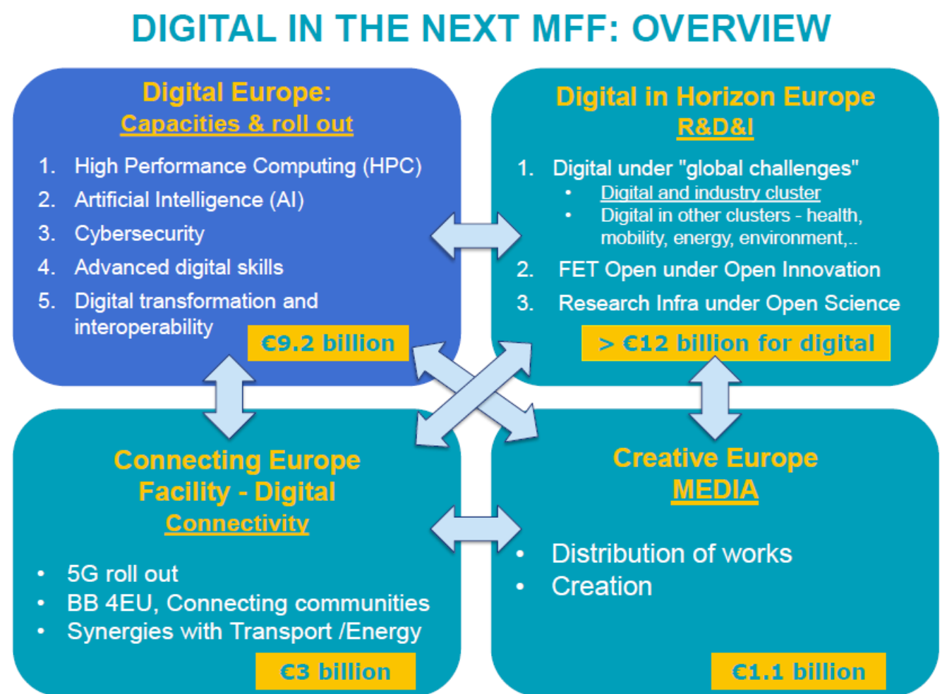

Slide 7
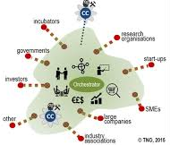
Hubs and Centers
Several EC units are involved, dealing with common digital market, connectivity, digital skills, high-performance computing (exascale computers + open cloud for R&I), research and innovation, and digital media.
Hubs should help to implement these plans.
They are new, central facility with world-leading infrastructure and support staff; promoting new and existing talent, providing a focal point for exchange and interaction of researchers at all stages of their careers, across all areas of AI. Should provide a global attractor for talent in AI and symbol for European excellence and ambition in AI. Have permanent scientific support staff, but no permanent scientific staff (only visitors, some of them longer-term).
Centers = Regional Excellence Centers. Selection of research labs, located strategically throughout Europe; strong roles as hubs for the members of the collaborative network in their region. Have permanent scientific and support staff.
Notes:
https://ellis.eu/units

Slide 8
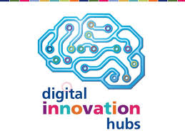
Digital Innovation Hubs
European Digital Innovation Hubs (EDIH)
Digital Europe Programme will invest €9.2 billion to align the next EU budget 2021-2027 with digital challenges. In a series of workshops, the European Digital Innovation Hubs (EDIHs) will focus on improved hub facilities and employment of personnel to deliver services that stimulate a broad uptake of Artificial Intelligence, HPC and Cybersecurity, in both industries (in particular SMEs and midcaps) and public sector organizations.
European catalogue of DIHs is a repository that includes more than 450 existing hubs across Europe, 368 tagged “AI/cognitive systems” (as of 1.07.2020).
EOSC is the European Open Science Cloud, a supporting environment to accelerate the transition to more effective Open Science and Open Innovation in a Digital Single Market by removing the technical, legislative and human barriers to the re-use of research data and tools, and by supporting access to services, systems and the flow of data across disciplinary, social and geographical borders.

Slide 9
4 Centers of Excellence in AI
11/2019 call for a vibrant European Network of AI Excellence Centers, 50 M€ from H2020 for 4 projects.
https://ec.europa.eu/newsroom/dae/document.cfm?doc_id=59492
In March 2020 results were announced, 4 winners were granted each 12 M€ to form large distributed AI centers of excellence. Grant period 9/2020-2023.
Two large EU networks are involved:
European Lab for Learning and Intelligent Systems (ELLIS), ELLIS network has 27 units in 13 different countries.
ELISE, European Learning and Intelligent Systems Excellence, coordinated by Aalto University, includes 202 core contributors in 105 organisations.
Goal: establish best European research in machine learning, integrating academia, industry and society, training students, including all ways of reasoning, all types of data, applicable for almost all sectors of science and industry, striving for explainable and trustworthy outcomes.
Notes:
https://ellis.eu/units

Slide 10
ELLIS
European Lab for Learning and Intelligent Systems (ELLIS) has 11 programs, covering all aspects of AI and robotics:
ELLIS Health
ELLIS Robot Learning: Closing the Reality Gap!
Geometric Deep Learning
Human-centric Machine Learning
Interactive Learning and Interventional Representations
Machine Learning and Computer Vision
Machine Learning for Earth and Climate Sciences
Natural Intelligence
Quantum and physics based machine learning
Robust Machine Learning
Theory, Algorithms and Computations of Modern Learning Systems
Notes:
https://ellis.eu/units

Slide 11
Centers of Excellence in AI
3 projects came from EurAI CLAIR, the World’s largest Network for AI Research (over 3500 supporters, including almost 1000 industrial).
CLAIRE Research Network is a pan-European Confederation of Laboratories for AI, strategically located throughout Europe (269 research groups + institutions, representing over 14 000 people).
HumanE-AI-Net
Human-centered AI
HumanE-AI-Net includes members of ELLIS. It is focused on AI systems that enhance human intelligence and adheres to European ethical values. Five major streams were identified:
Human-in-the-Loop Machine Learning, Reasoning, and Planning
Multimodal Perception and Modelling
Human AI Interaction and Collaboration
Societal AI
AI Ethics, Law and Responsible AI
Notes:
https://ellis.eu/units

Slide 12
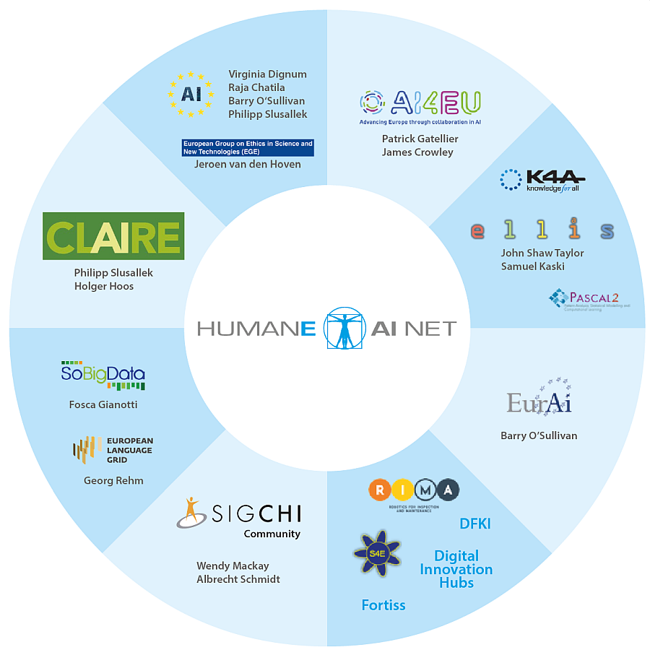
Notes:
https://ellis.eu/units

Slide 13
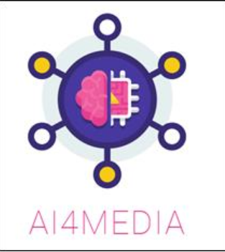
TAILOR & AI4Media
TAILOR - Foundations of Trustworthy AI - Integrating Learning, Optimization and Reasoning, child of CLAIRE,
TAILOR will create a network of research excellence centers across all of Europe on the Foundations of Trustworthy AI based on 1) a strategic roadmap committee, 2) basic research program to address grand challenges in health, mobility and resource management,3) a connectivity fund for active dissemination to the larger AI community, 4) network collaboration activities promoting research exchanges, training materials, and joint PhD supervision.
AI4Media - A European Excellence Centre for Media, Society and Democracy.
30 partners in the areas of AI and media (9 universities, 9 research centers, 12 industrial partners) and 35 associate members, will establish the networking infrastructure to bring together the European AI landscape in the field of media, involving academia and industry, Digital Innovation Hubs. All aspects of AI, improve the democratic role of the media, Smart News Assistant to support journalists, social media, recognition of digital content creation, creation, curation, verification, validation of news stories, Media AI Observatory, AI-based video content automation.
Notes:
https://ellis.eu/units

Slide 14
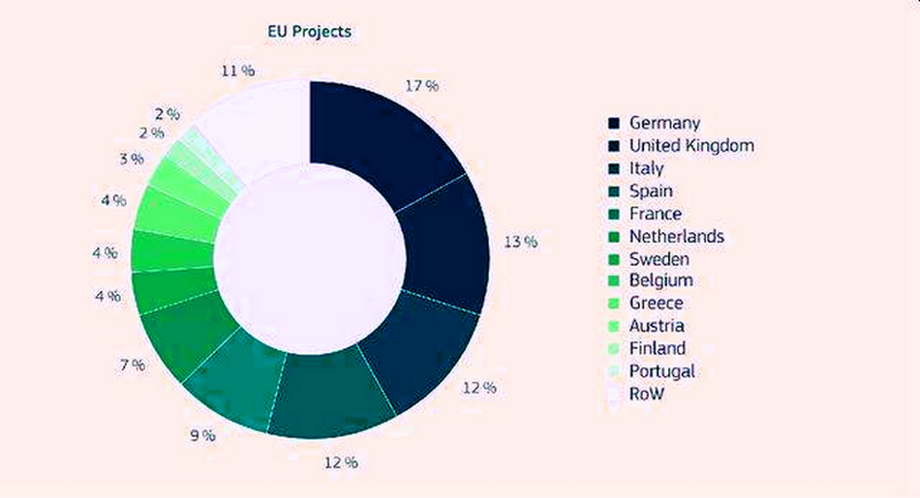
Funding of AI-related research
Distribution of EU players (%) in EU-funded AI research projects, 2009-2018

Slide 15
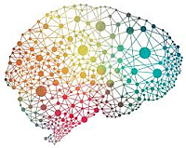
Neuroscience => AI
Hassabis, D., Kumaran, D., Summerfield, C., Botvinick, M. (2017). Neuroscience-Inspired Artificial Intelligence. Neuron, 95(2), 245–258.
Affiliations: Google DeepMind, Gatsby Computational Neuroscience, Institute of Cognitive Neuroscience, Uni. College London, Uni. of Oxford.
Artificial neural networks – simple inspirations, but many applications.
Bengio, Y. (2017). The Consciousness Prior. ArXiv:1709.08568.
Amoset al. (2018). Learning Awareness Models. ArXiv:1804.06318.
AI Systems inspired by Neural Models of Behavior: (A) Visual attention, foveal locations for multiresolution ‘‘retinal’’ representation, prediction of next location to attend to. (B) Complementary learning systems and episodic control: fast learning hippocampal system and parametric slow-learning neocortical system. (C) Models of working memory and the Neural Turing Machine.
(D) Neurobiological models of synaptic consolidation and the elastic weight consolidation (EWC) algorithm.

Slide 16
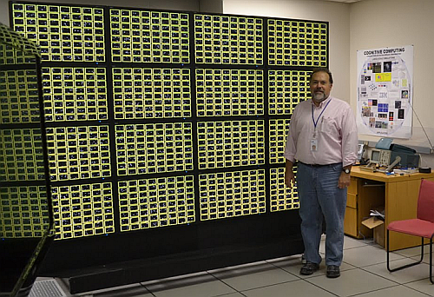
Neuromorphic future
SyNAPSE Project 2015: IBM TrueNorth chip ∼1M neurons i 250M synapses (5.4G transistors),
1 module=16 chips=16M neurons, 4G synapses, needs 1.1 W of power!
Scaling: 256 modules=1024 chips, 4G neuronów, 1T (10¹²) synapses, < 300 W, 48 Gops/Wat!
This wall has ¼ complexity of gorilla brain and 1/20 of human brain.
New wave of AI computing: CPU, GPU, ASIC (np. FPGA) now neuromorphic chips. Samsung Dynamic Vision Sensor (DVS) is based on TrueNorth chips.
Intel Loihi chip (2017), ~ 68 Gops/W, Pohoiki Springs system, available to members of the Intel Neuromorphic Research Community 3/2020.
Gyrfalcon (2017) DSP small chip, 24.3 Tops/W, processing in memory.
How to use them?

